Slide 1
Mobile Analysis 2023 Report
Comprehensive Overview of Mobile Phones in the Market

Slide 2
Introduction
This project provides insights into the mobile phone market using SQL and Power Bi. The objective is to assist consumers and stakeholders in making informed decisions.

Slide 3
Project Description
The analysis includes a comprehensive review of mobile phones, covering features, prices, brands, operating systems, battery capacity, 5G availability, and internal storage. SQL queries and Power Bi are used for data extraction and visualization.

Slide 4
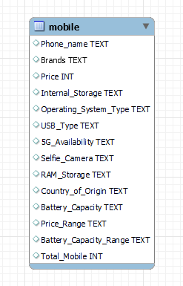
Entity relationship diagram

Slide 5
Database and Tools
The primary tools used are MySQL and Power BI. MySQL is employed for data analysis, and Power Bi is used for effective data visualization. These tools play a crucial role in deriving valuable insights from the data.

Slide 6

1. Can you provide a list of mobile features and their prices?

Slide 7

2. What are the 5 most expensive phones available?

Slide 8

3. What are the 5 cheapest phones available?

Slide 9

4. Can you list the top 5 Samsung phones with their prices and all features?

Slide 10

5. What are some must-have Android phones and the top 5 high-priced Android phones?

Slide 11

6. What are some must-have Android phones and the top 5 low-priced Android phones?

Slide 12

7. What are some must-have iOS phones and the top 5 HIGh-priced iOS phones?

Slide 13

8. What are some must-have iOS phones and the top 5 low-priced iOS phones?

Slide 14

9. Which phones support 5G and what are the top 5 phones with 5G support?

Slide 15
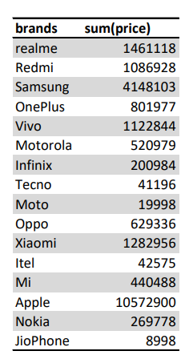

10. What is the total price of all mobile phones, sorted by brand name?

Slide 16
Creating Dashboards with Power BI
Power BI is utilized to create interactive dashboards for visualizing the 'Mobile Analysis 2023' report. These dashboards provide a dynamic and effective representation of the data for stakeholders.

Slide 17
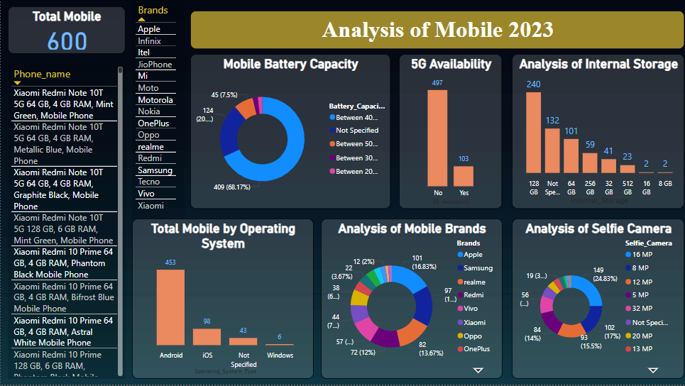

Slide 18
conclusion
The “Mobile Analysis 2023” project has provided us with a comprehensive overview of various mobile phones available in the market, focusing on their features, prices, and other essential aspects. I have used the PowerBI dashboard and SQL queries to extract valuable insights to assist consumers and stakeholders in making informed decisions. I have identified the must-have features and the top high-priced and low-priced phones for both Android and iOS operating systems. I have also listed the phones that support 5G and the total price of all mobile phones sorted by brand name. I hope that this report will help you choose the best mobile phone for your needs and preferences. Thank you for reading our report.

Slide 19
Thank you !

